Slide 1
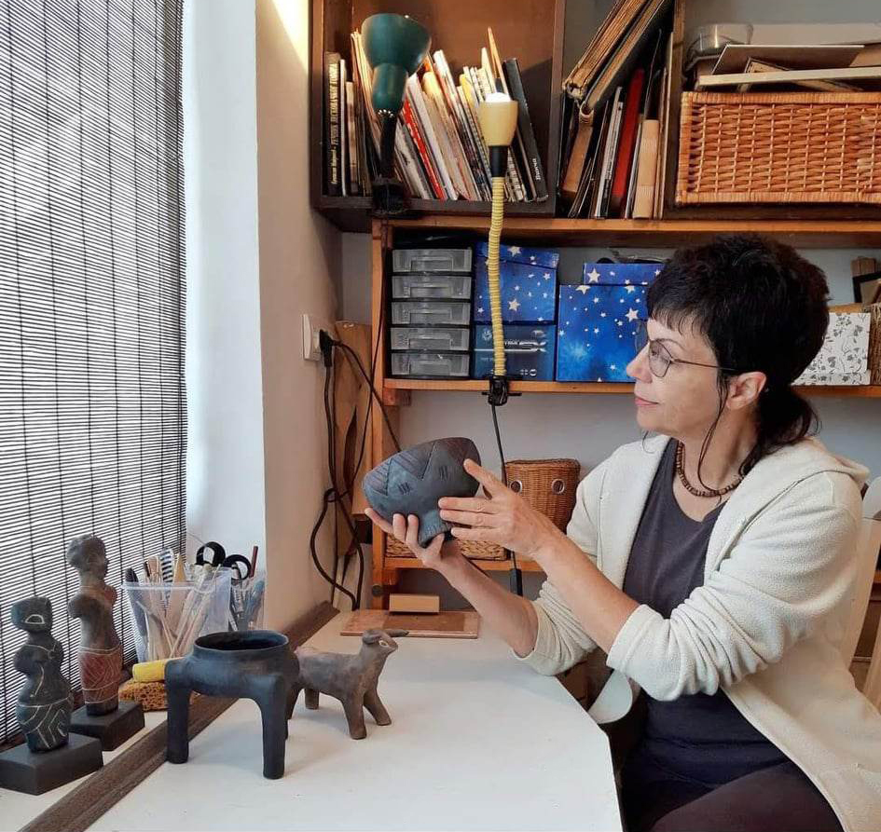

Milena Nikolić

Slide 2
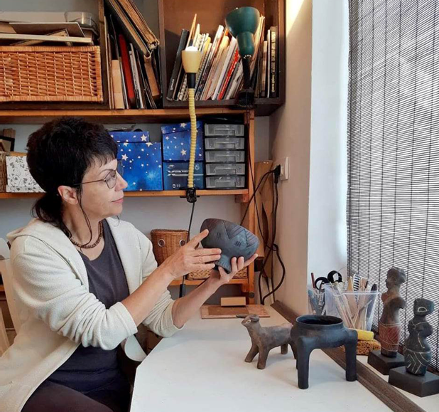
Ceramic artist Milena Nikolić makes replicas of artefacts of the Vinca culture from the Neolithic sites in Serbia. She has reached a high professional level at making souvenirs. The process of making them almost completely replicates the way of work of prehistoric people. She does not use modern technology or a potter's wheel but makes each piece by hand. It can be said that each replica is unique.

Slide 3
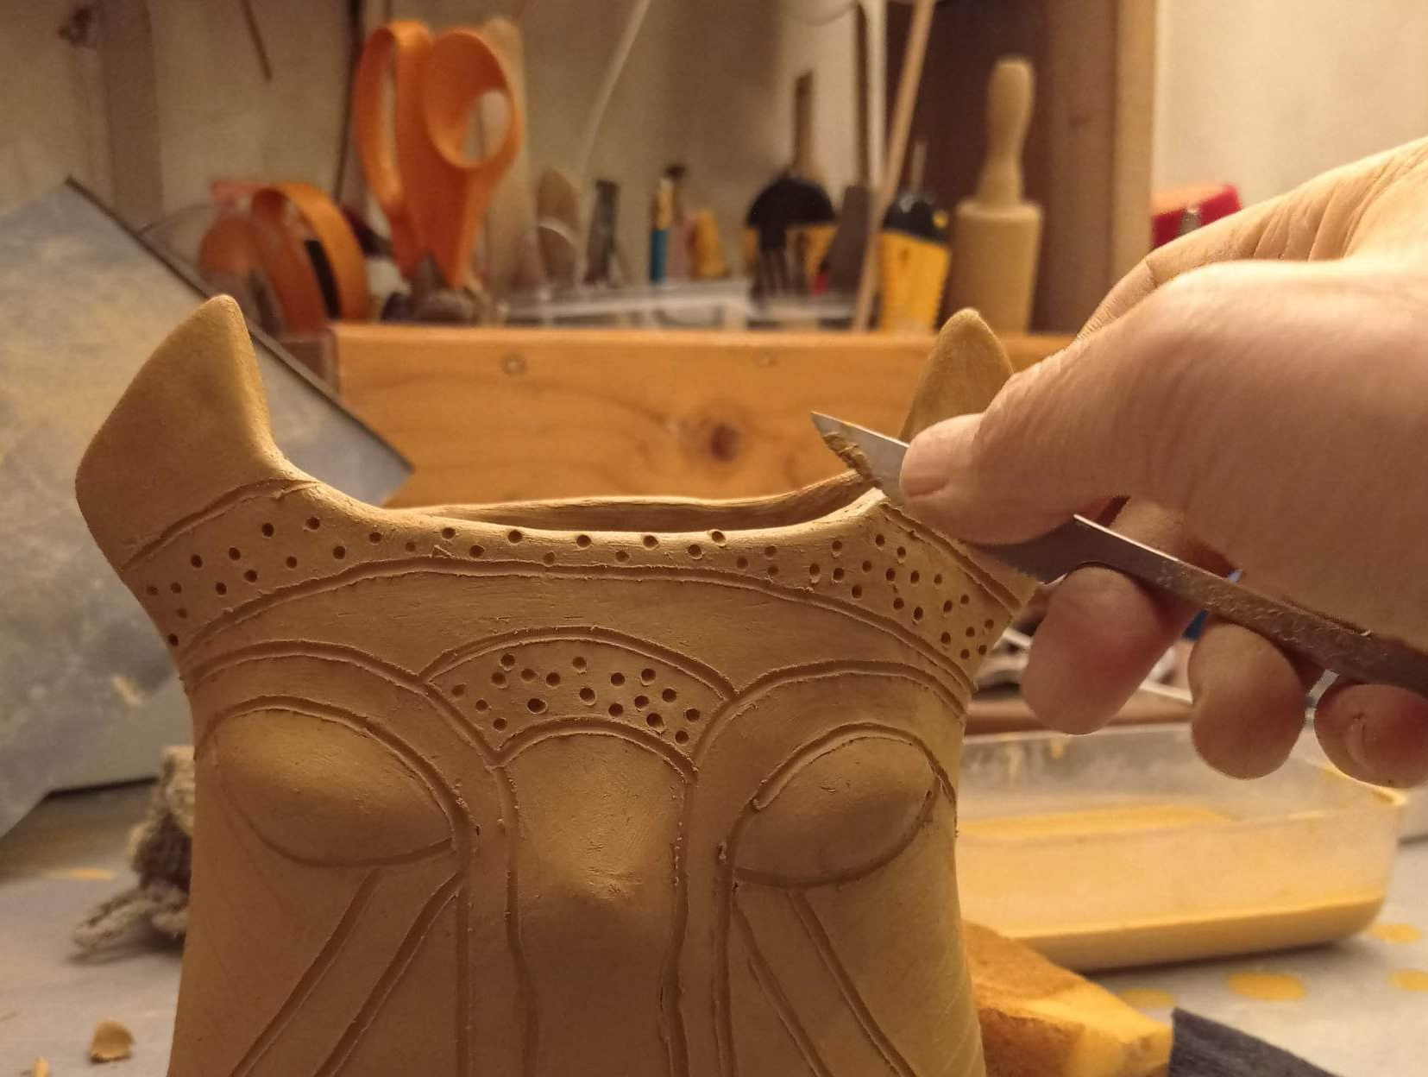
Replicas can be divided into several groups according to their shape and purpose - anthropomorphic and zoomorphic figurines, protomorphic lids, altars, vessels, but also jewelry inspired by prehistoric times.

Slide 4
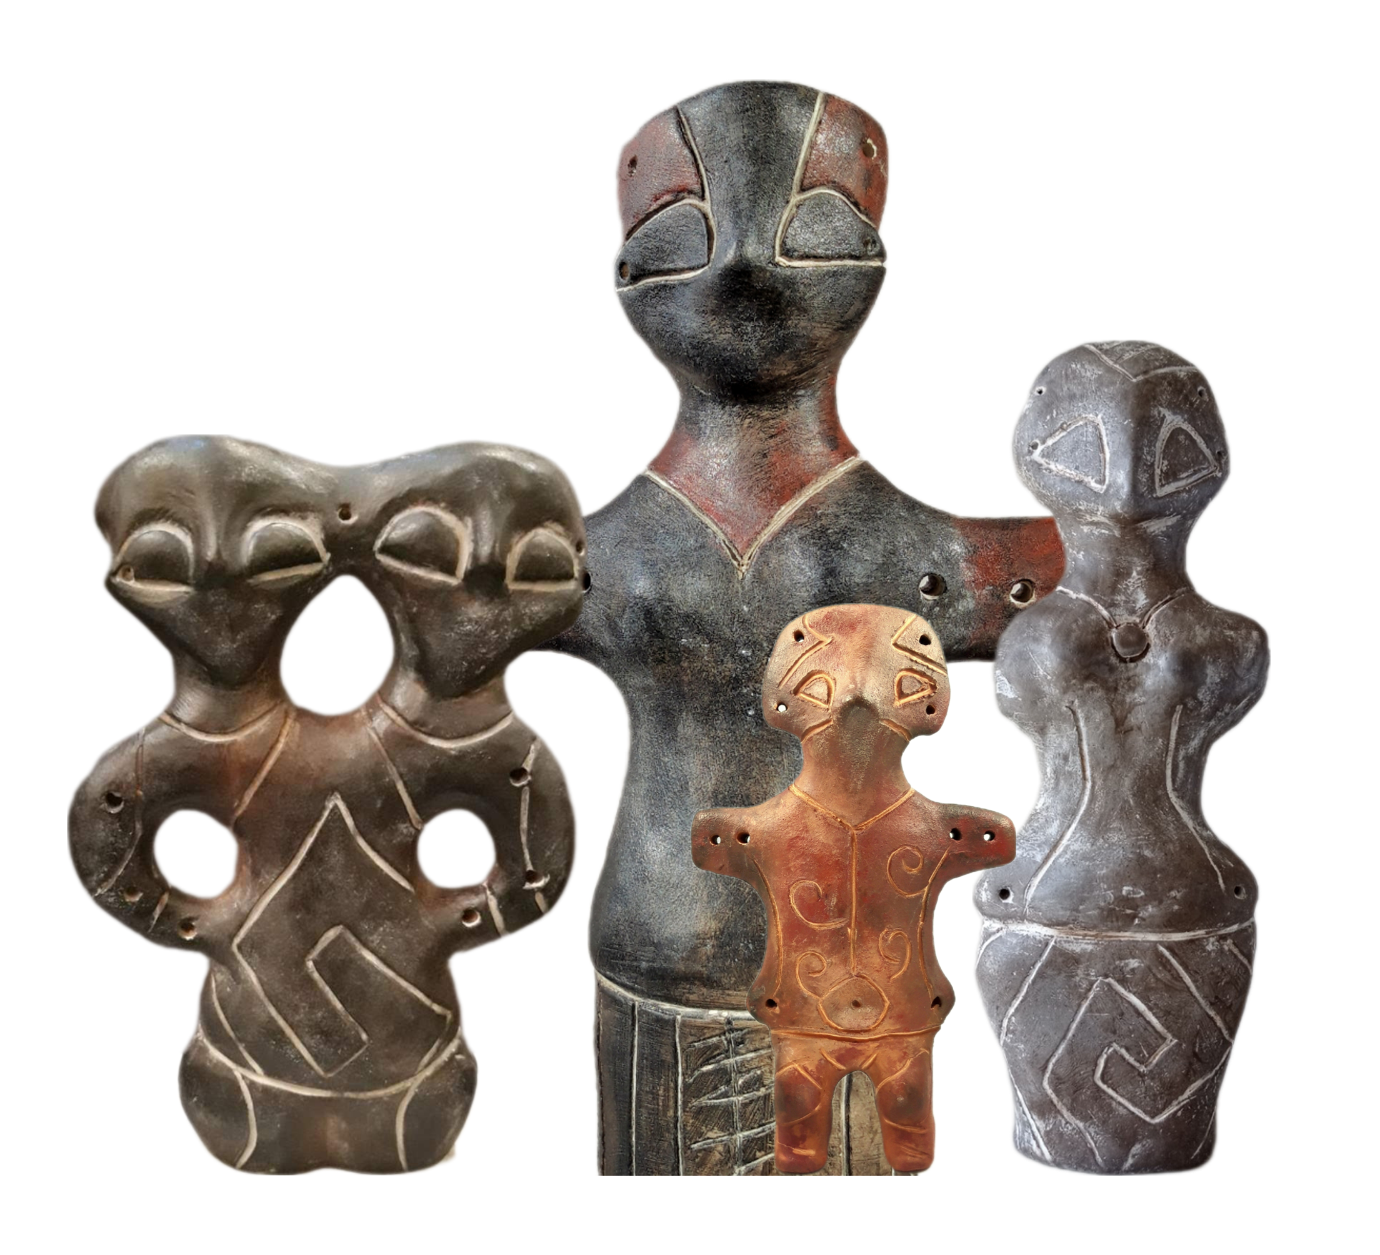
ANTHROPOMORPHIC FIGURINES
The figurines in the Vinca home were relics with a protective function and distinguished by large eyes. They are frequently figurines of women indicating the cult of the mother, according to some archaeologists. The great mother is there to watch over the home and
family at all times.
Although Vinca culture was widespread, standardization can be observed. A similar physiognomy, typical waist, and details on the clothes characterize all figurines. Their aesthetic level can be compared with the works of contemporary authors.

Slide 5
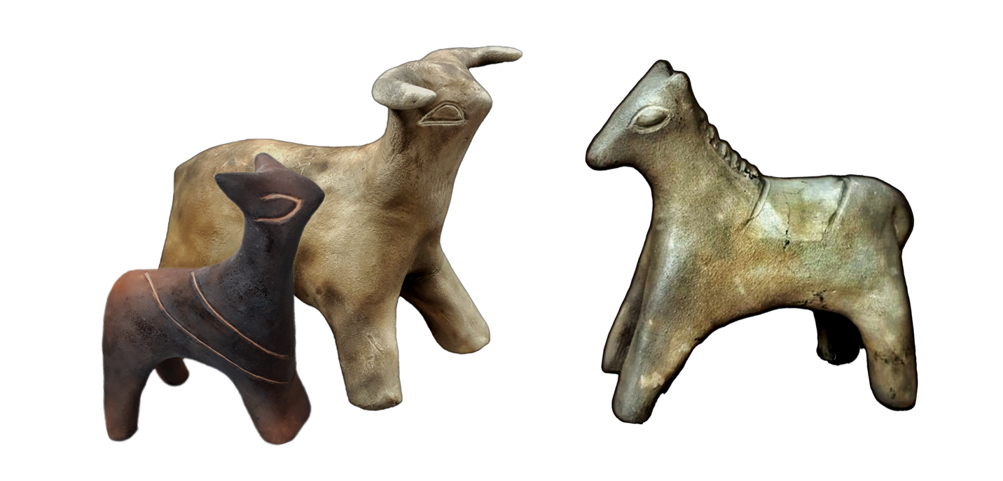
Zoomorfne Figurine
Zoomorphic figurines were an integral part of the Vinca household. It assumes that they were used for ritual purposes or as toys for children.

Slide 6
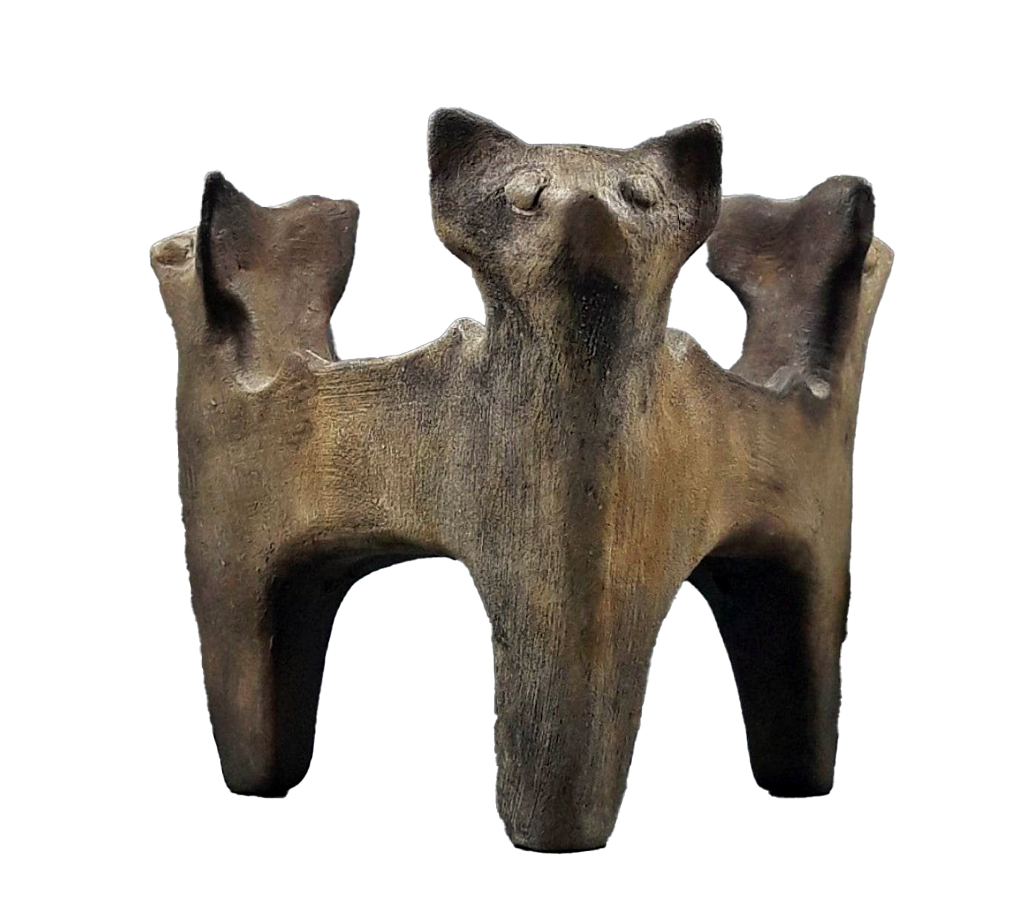
SACRIFICES
In the Vinca culture, altars made in various shapes and sizes had shallow receptacles for burning sacrificial gifts, possibly grains.
There was a small size, for homes and large central ones where sacrifices were made for the benefit of the entire community.

Slide 7
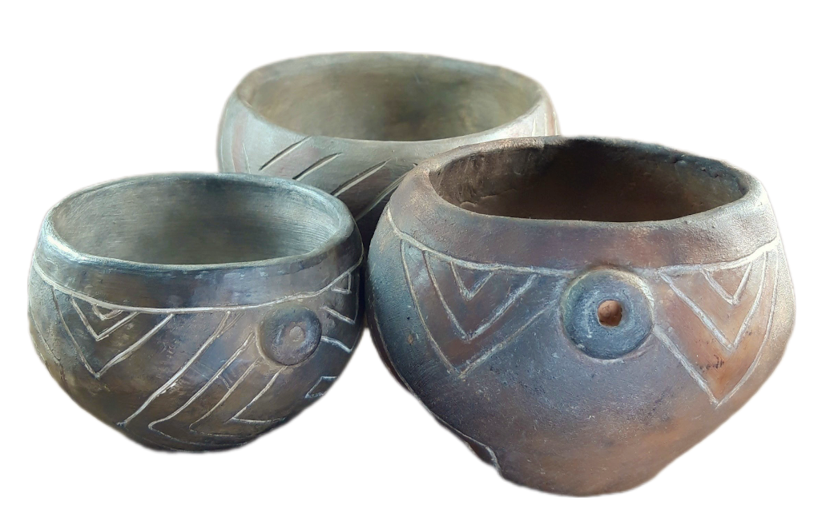
vessels
The vessels for everyday use, as well as those for food preparation, were made of high quality, pigmented, and decorated with characteristic Vinca ornaments.

Slide 8
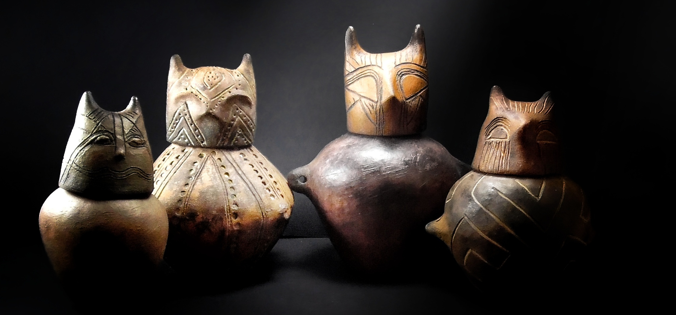
prosopomorphic LIDS
These lids are particular forms of ceramic production of the Vinca culture. Except for closing containers, lids are usually in the shape of a cat's or owl's head, they also had the role of protecting their content from all harmful influences.

Slide 9
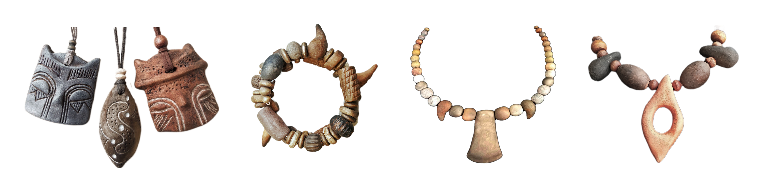
JEWELRY
In addition to replicas, Milena also creates jewelry inspired by Vinca culture and the Lepenski Vir with great enjoyment.

Slide 10
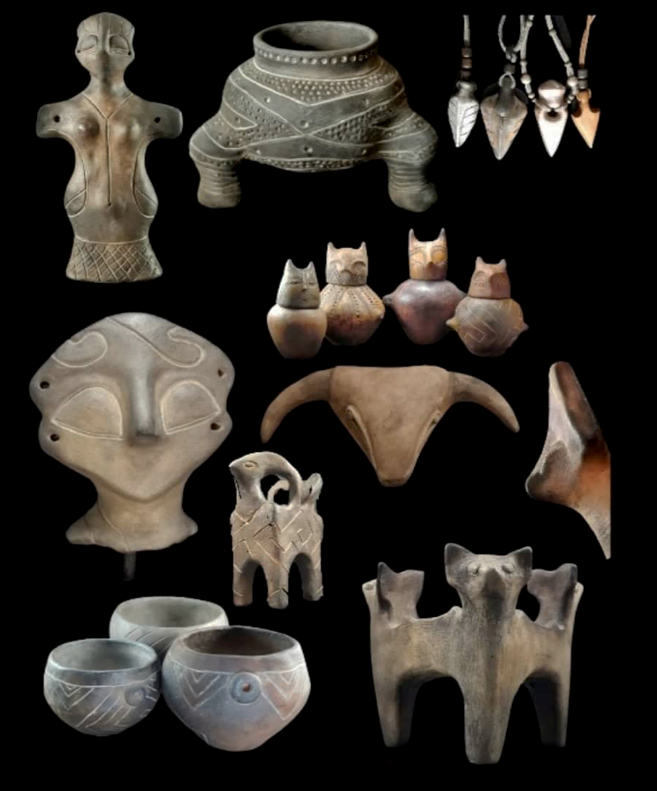
She comes from the distinguished Nikolić family. For half a century, three generations have been engaging in artistic and industrial ceramics conveying their love for long-gone times, carrying with them a handful of untold stories. The replicas from their workshop, which Milena creates with love, can be found in the National Museum in Belgrade, several other museums and galleries, and in private collections in Serbia and abroad. In this way, Milena and her family nurture and preserve the cultural and historical heritage created in this area many millennia ago. Thus, they are ambassadors proudly affirming Serbia as the cradle of that prominent and peaceful culture.

Slide 11
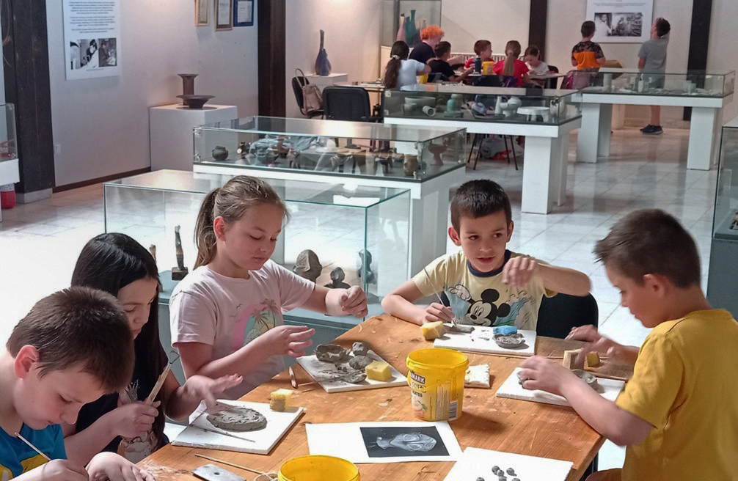
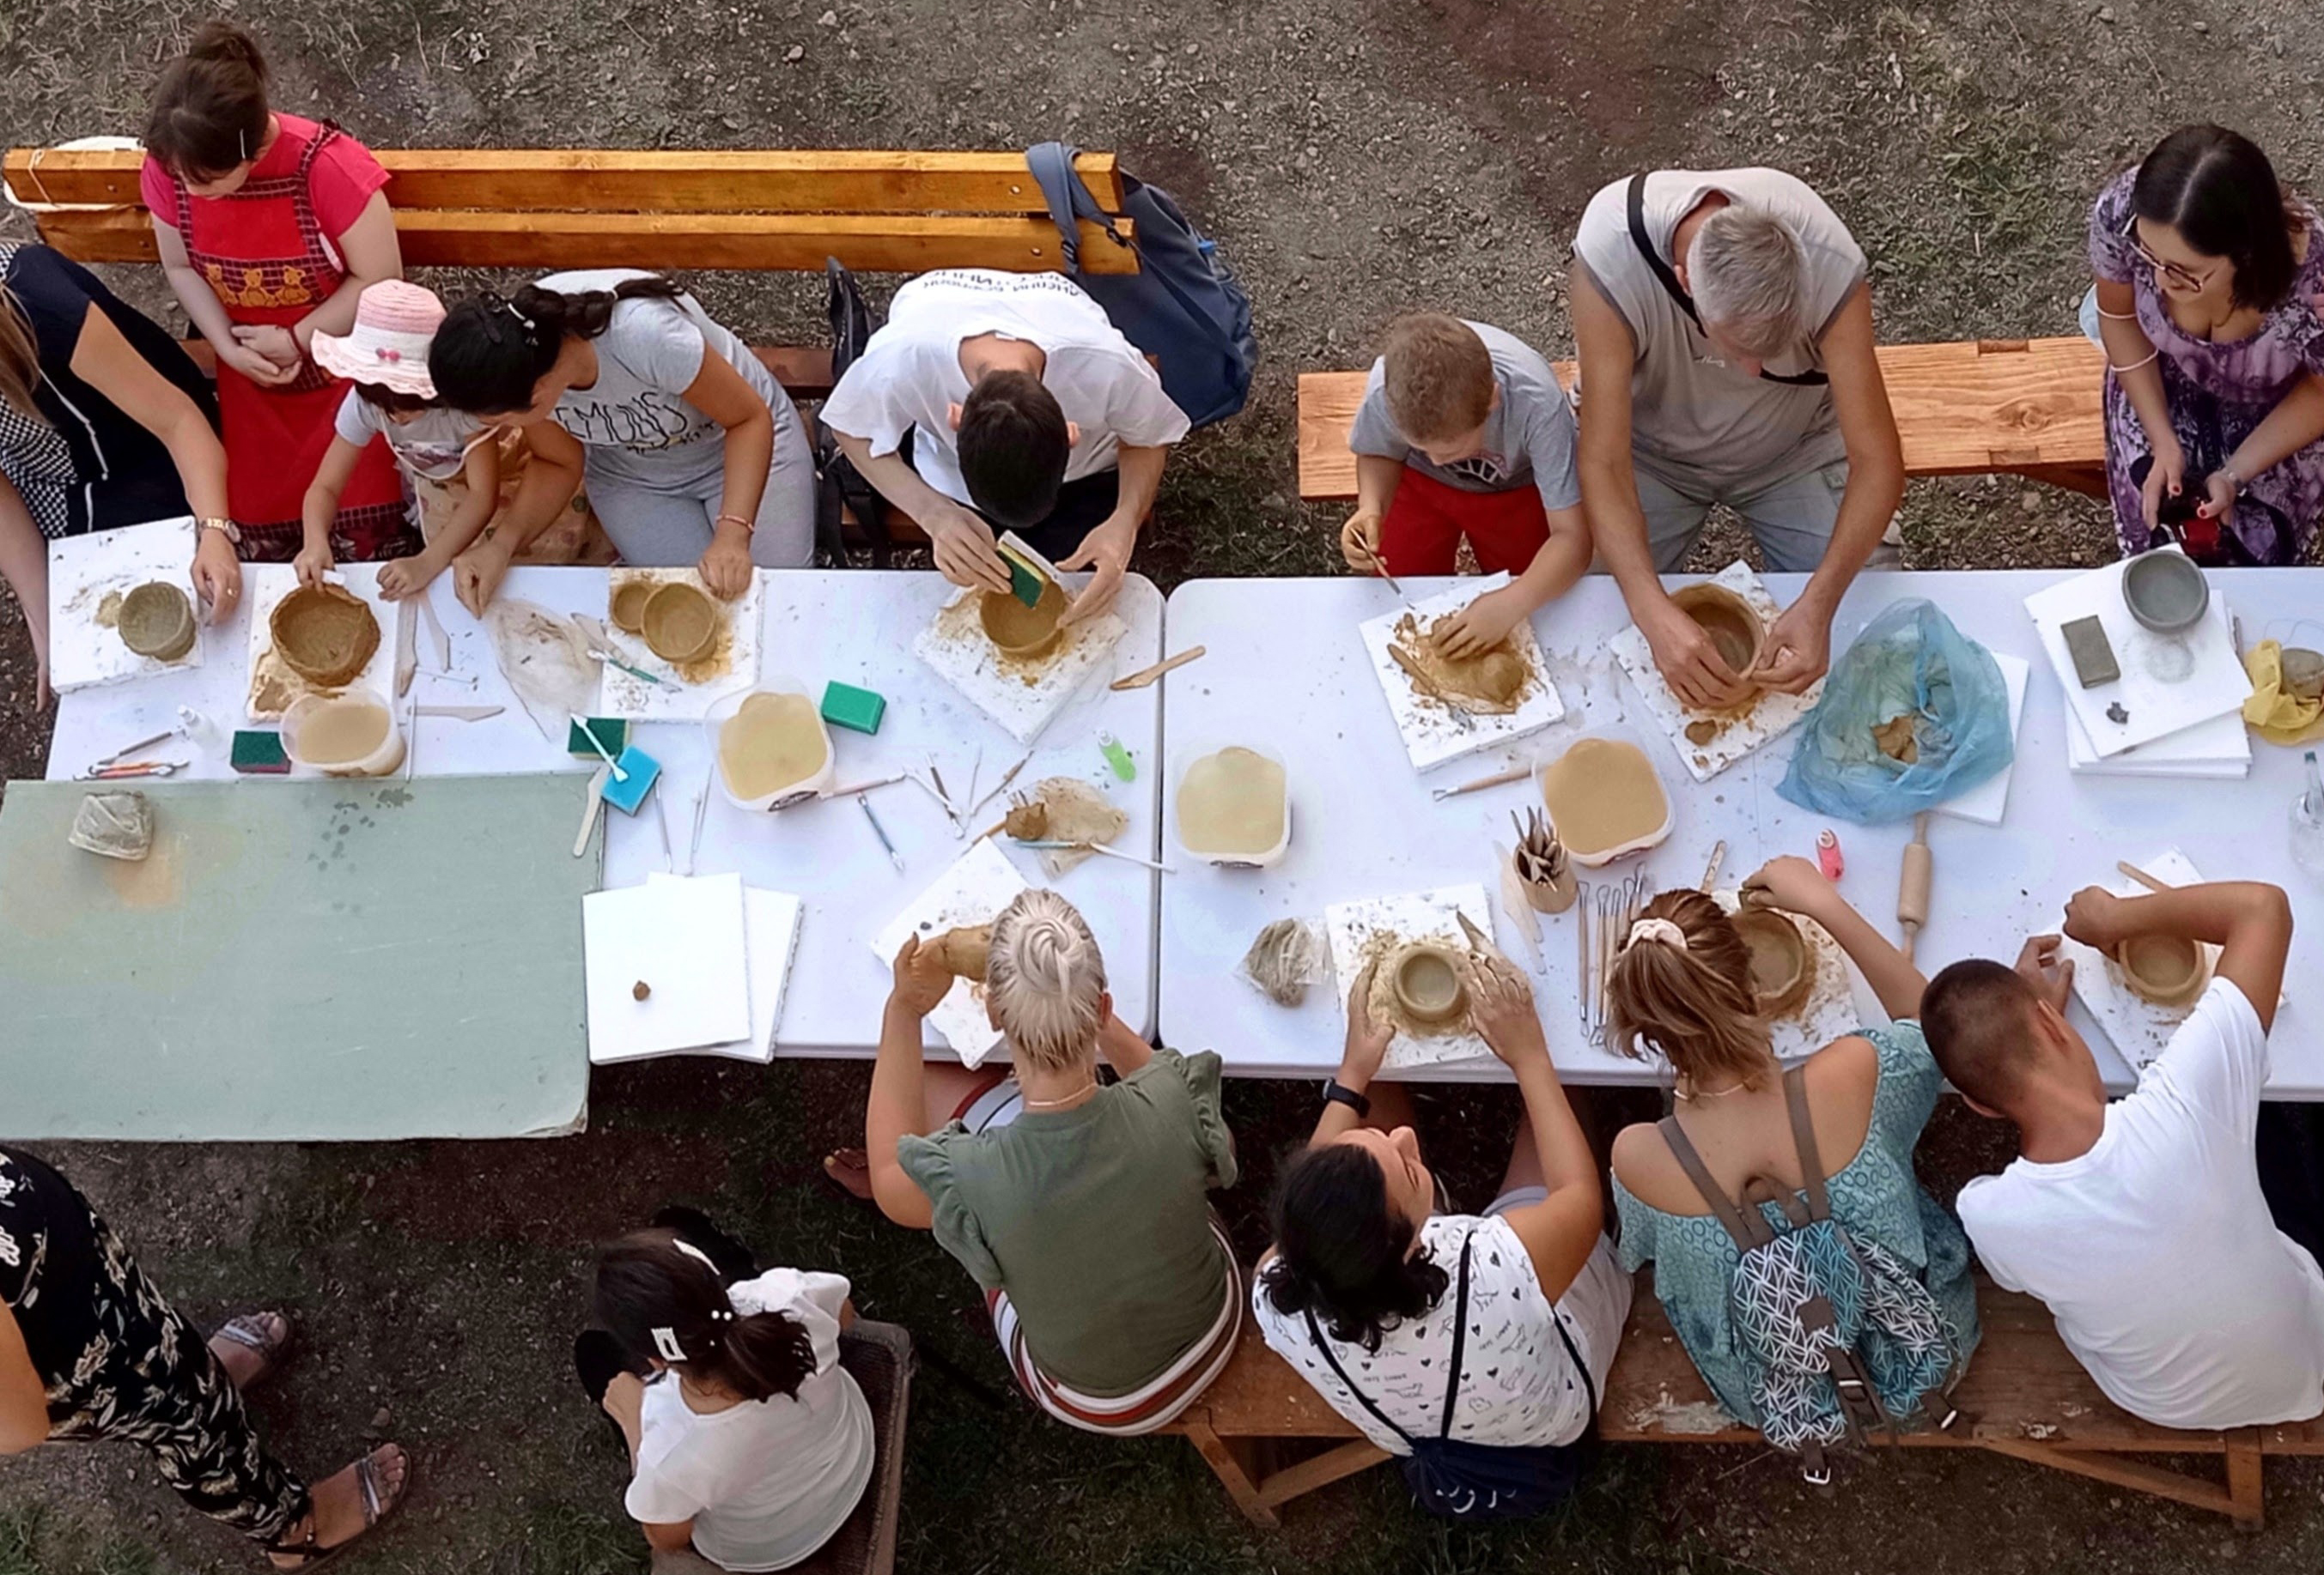
Participating in children's ceramic workshops in museums and other cultural institutions, Milena initiated a new meaning and spirit in their creativity. Introducing children to the ancient working techniques with clay, she thus points them to the way of life and craft of Vinca masters.

Slide 12
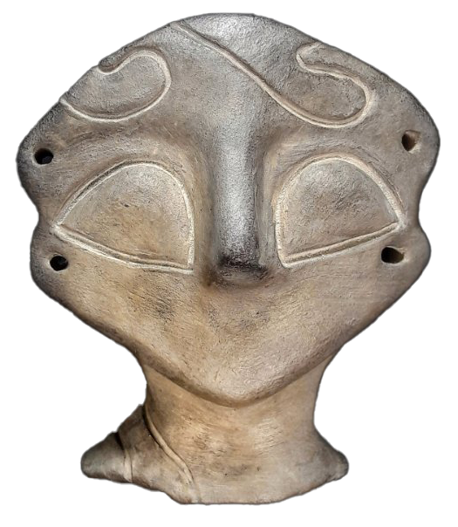
The art is inspired by time and bears its stamp. The epoch of Vinca culture is a part of Milena's being which she carries in her heart. She feels accountable for preserving and spreading awareness of the importance and aesthetic achievements of Vinca culture.

Slide 13
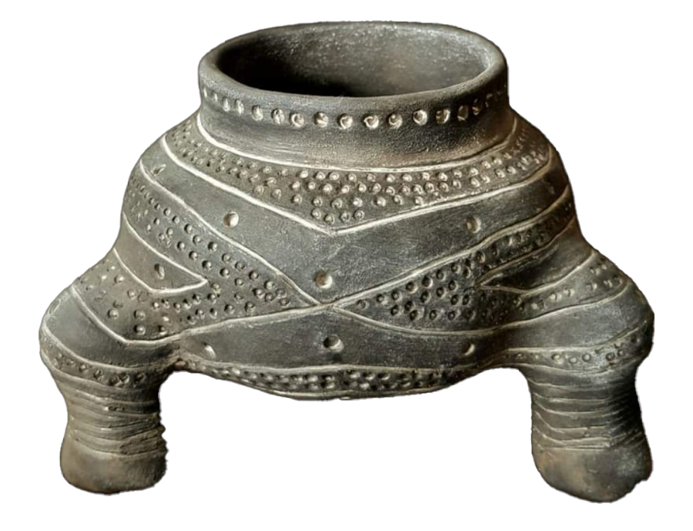
The Vinca culture was one of the most advanced cultures of the European Neolithic. It covers the period from 5200 to 4600 BC. It spread over the territory of today's Serbia, Romania, North Macedonia and Bosnia and Herzegovina.
The bearers of this culture lived at comfortably built houses made of wicker and mud in well-organized settlements with straight streets and "squares". The remains indicate that the people of Vinca had maintained trade relations with other prehistoric cultures in Central Europe, the Carpathian region and on the coast of the Mediterranean Sea. Their belief system and the weapons missed from that period indicate that they were not warriors. Their high-quality original art and craft still inspire admiration today. According to some assumptions, they were the first to start melting metals and had a calendar and the first alphabet.

